Slide 1
Windows & DirectX programming basics

Slide 2
Objectives
Can create a simple DirectX drawing project.

Slide 3
References
Beginning Game Programming
  Chapter 2 - 5

Slide 4
Windows programming

Slide 5
Windows
Pre-emptive multi-tasking
Multi-threading
Event-driven
  Still remember the message queue?

Slide 6
DirectX components
Graphic: Direct3D
DirectX Audio:
  DirectMusic
  DirectSound
  DirectSound3D
DirectInput
DirectPlay: obsoleted

Slide 7
Hello, world in C
#include <windows.h>
int WinMain(
HINSTANCE hInstance,
HINSTANCE hPrevInstance,
LPSTR lpCmdLine,
int nCmdShow)
{
MessageBox(NULL,”This is hello world!”,”Hello, World”, MB_OK | MB_ICONEXCLAMATION);
}
HINSTANCE
H = Handle – usually an integer to identify something
HINSTANCE = Handle of a program instance

Slide 8
Hello, world in C
#include <windows.h>
int WinMain(
HINSTANCE hInstance,
HINSTANCE hPrevInstance,
LPSTR lpCmdLine,
int nCmdShow)
{
MessageBox(NULL,”This is hello world!”,”Hello, World”, MB_OK | MB_ICONEXCLAMATION);
}
hInstance: handle of this running instance.
hPrevInstance: handle of the previous instance (mostly used to prevent app from being run more than once)

Slide 9
Hello, world in C
#include <windows.h>
int WinMain(
HINSTANCE hInstance,
HINSTANCE hPrevInstance,
LPSTR lpCmdLine,
int nCmdShow)
{
MessageBox(NULL,”This is hello world!”,”Hello, World”, MB_OK | MB_ICONEXCLAMATION);
}
LPSTR: Long Pointer to STRing
lpCmdLine: pointer to the command line string.
nCmdShow: how to display the Window.

Slide 10
Real Window program!
#include <windows.h>
int WinMain(HINSTANCE hInstance,
HINSTANCE hPrevInstance, LPSTR lpCmdLine, int nCmdShow)
{
WNDCLASSEX wc;
wc.cbSize = sizeof(WNDCLASSEX);
wc.style = CS_HREDRAW | CS_VREDRAW;
wc.hInstance = hInstance;
wc.lpfnWndProc = (WNDPROC)WinProc;
wc.cbClsExtra = 0;
wc.cbWndExtra = 0;
wc.hIcon = NULL;
wc.hCursor = LoadCursor(NULL, IDC_ARROW);
wc.hbrBackground = (HBRUSH)GetStockObject(WHITE_BRUSH);
wc.lpszMenuName = NULL;
wc.lpszClassName = APP_CLASS;
wc.hIconSm = NULL;
RegisterClassEx(&wc);
Register a new Window Class
Notes:
Doan source mo ta cach dang ky 1 lop cua so moi

Slide 11
Real Window program!
#include <windows.h>
int WinMain(HINSTANCE hInstance,
HINSTANCE hPrevInstance, LPSTR lpCmdLine, int nCmdShow)
{
WNDCLASSEX wc;
wc.cbSize = sizeof(WNDCLASSEX);
wc.style = CS_HREDRAW | CS_VREDRAW;
wc.hInstance = hInstance;
wc.lpfnWndProc = (WNDPROC)WinProc;
wc.cbClsExtra = 0;
wc.cbWndExtra = 0;
wc.hIcon = NULL;
wc.hCursor = LoadCursor(NULL, IDC_ARROW);
wc.hbrBackground = (HBRUSH)GetStockObject(WHITE_BRUSH);
wc.lpszMenuName = NULL;
wc.lpszClassName = APP_CLASS;
wc.hIconSm = NULL;
RegisterClassEx(&wc);
Specify the function to handle the messages sent to windows of this class – Window Procedure (WinProc)

Slide 12
Real Window program!
Create a window from the registered class
HWND hWnd =
CreateWindow(
APP_CLASS, // Window class name
"First Windows program!", // Title
WS_OVERLAPPEDWINDOW, // Window type
CW_USEDEFAULT, // Initial position
CW_USEDEFAULT,
800, // Width
600, // Height
NULL,
NULL,
hInstance, // Program instance
NULL);
if (!hWnd) return FALSE;
ShowWindow(hWnd,nCmdShow);
UpdateWindow(hWnd);
Display the window AND update the window’s content.

Slide 13
Real Window program!
MSG msg;
while (GetMessage(&msg, NULL, 0, 0))
{
TranslateMessage(&msg);
DispatchMessage(&msg);
}
return 0;
}
Wait until a message is available from the message queue (GetMessage) and send it to the appropriate window.
This message loop is NOT appropriate for real-time game, why?

Slide 14
A real game program
if (!GameInit(hWnd))
return FALSE;
int done = 0;
while (!done) {
if (PeekMessage(&msg,NULL,0,0,PM_REMOVE)) {
if (msg.message==WM_QUIT) done=1;
TranslateMessage(&msg);
DispatchMessage(&msg);
}
// Do our game stuff here
GameRun(hWnd);
}
GameEnd();
PeekMessage: Check if there is a message, get and remove that message from queue.

Slide 15
Get ready for DirectX

Slide 16
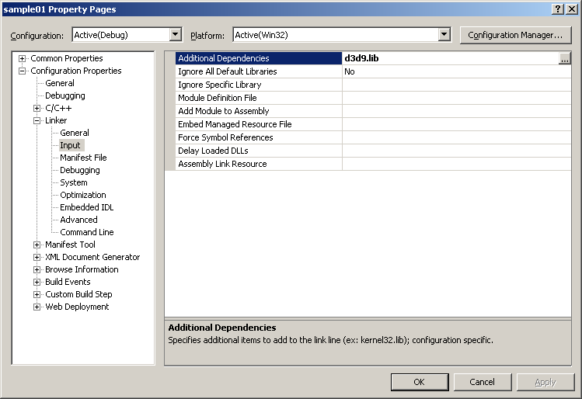
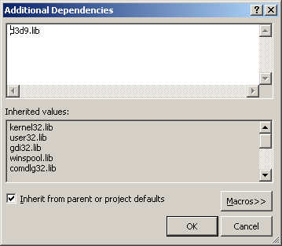
Tell VS2005 to link to DirectX lib
Project \ Properties

Slide 17
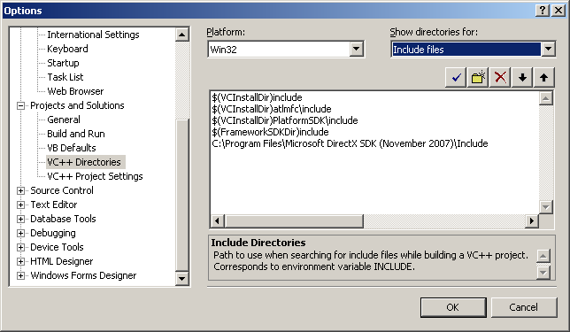
Tell VS2005 where to find .h files
Tools \ Options

Slide 18
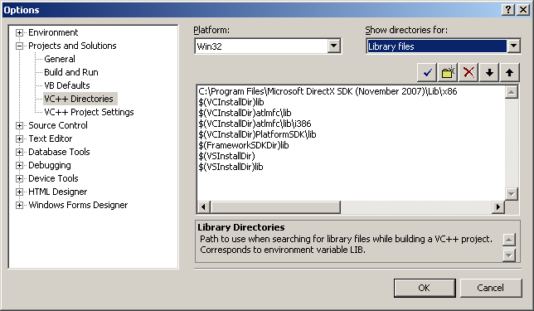
Tell VS2005 where to find .lib files
Tools \ Options

Slide 19
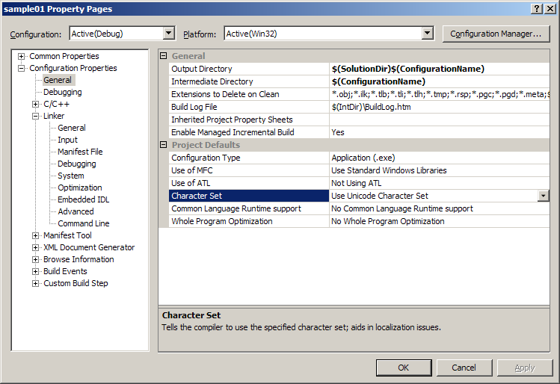
Use Unicode character set
Tools \ Options

Slide 20
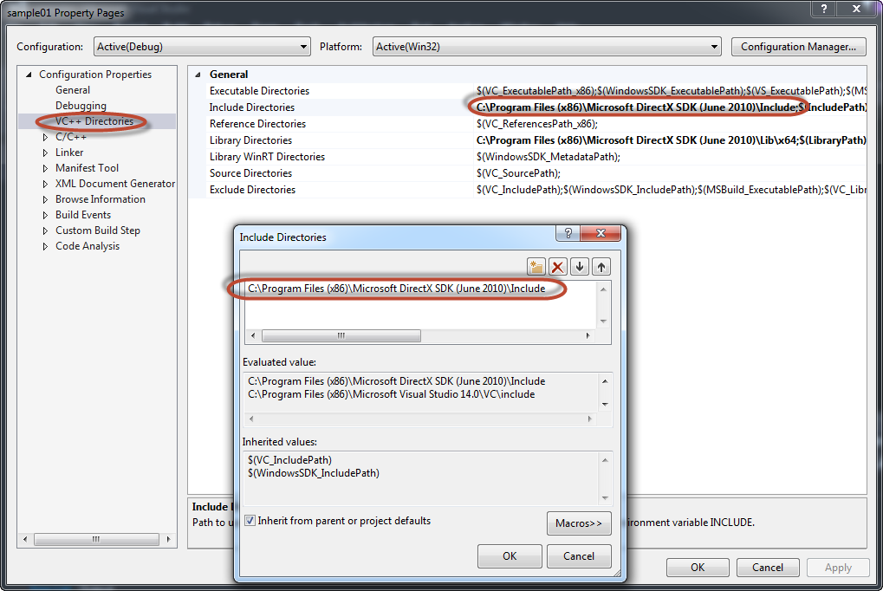
Tell VS2015 where to find .h files
sample01 \ Properties \ Configuration Properties \ VC++ Directories

Slide 21
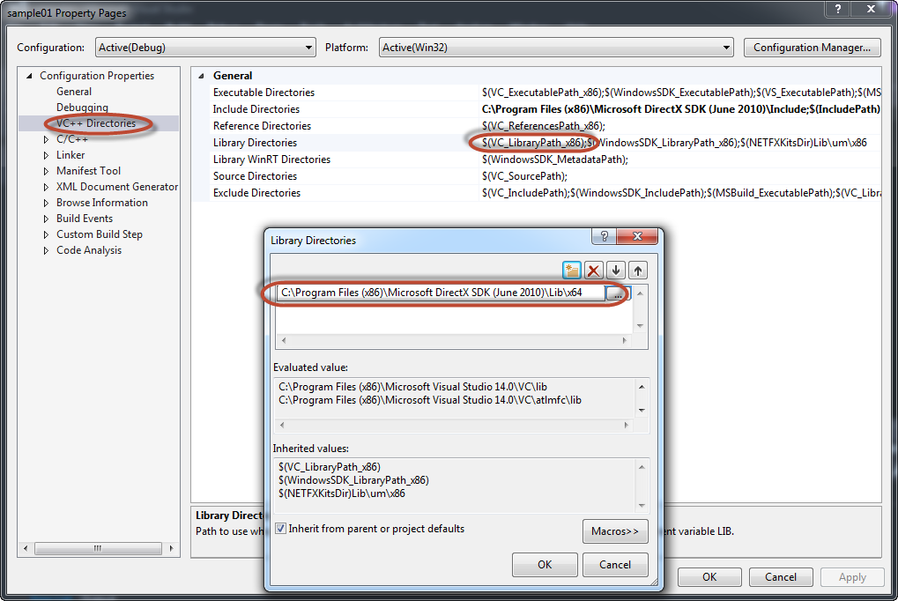
Tell VS2015 where to find .lib files
sample01 \ Properties \ Configuration Properties \ VC++ Directories

Slide 22
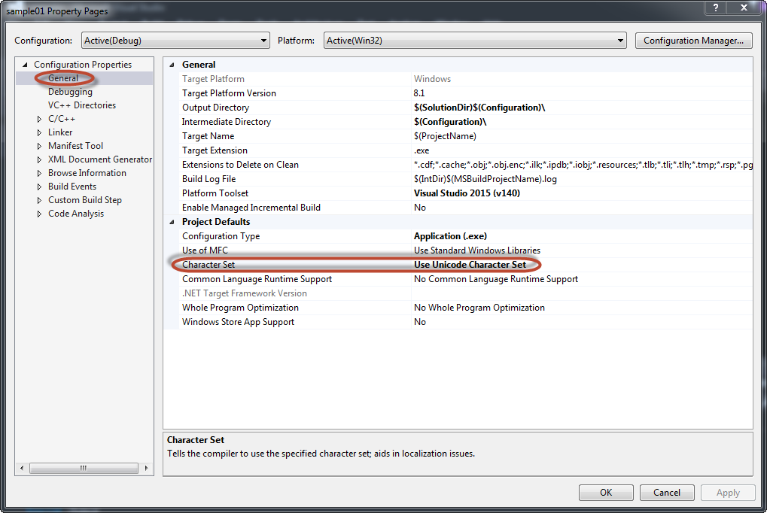
Tell VS2015 to use Unicode character set
sample01 \ Properties \ Configuration Properties \ General

Slide 23
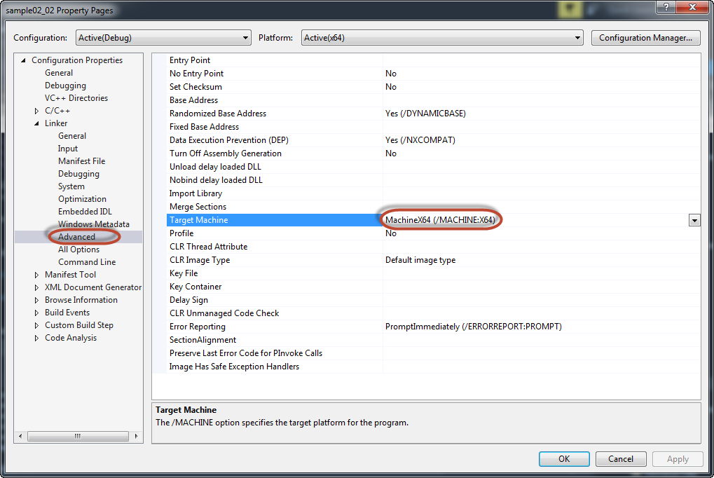
Change the building platform to x64 (if want to change the desired platform of executable file to x64)
Configuration Properties \ Linker \ Advanced \ Target Machine

Slide 24
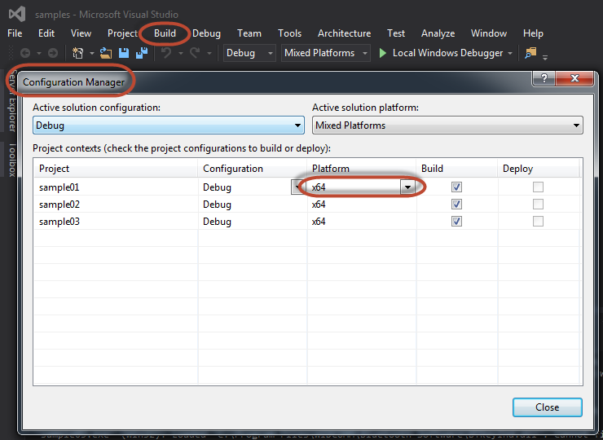
Change the building platform to x64 (if want to change the desired platform of executable file to x64)
Build \ Configuration Manager

Slide 25
An empty DirectX program

Slide 26
An empty DirectX program
int GameInit(HWND hWnd) {
d3d = Direct3DCreate9(D3D_SDK_VERSION);
D3DPRESENT_PARAMETERS d3dpp;
ZeroMemory( &d3dpp, sizeof(d3dpp) );
d3dpp.Windowed = TRUE;
d3dpp.SwapEffect = D3DSWAPEFFECT_DISCARD;
d3dpp.BackBufferFormat = D3DFMT_UNKNOWN;
d3d->CreateDevice(
D3DADAPTER_DEFAULT,
D3DDEVTYPE_HAL,
hWnd,
D3DCREATE_SOFTWARE_VERTEXPROCESSING,
&d3dpp,
&d3ddv);
if (d3ddv==NULL) {
MessageBox(NULL,"Failed to create device","Error",MB_OK);
return 0;
}
return 1;
}

Slide 27
An empty DirectX program
void GameRun(HWND hWnd) {
d3ddv->Clear(0, NULL,D3DCLEAR_TARGET,D3DCOLOR_XRGB(0,255,255),1.0f,0);
if (d3ddv->BeginScene()) {
// Draw something here
d3ddv->EndScene();
}
d3ddv->Present(NULL,NULL,NULL,NULL);
}
void GameEnd() {
if (d3ddv!=NULL) d3ddv->Release();
if (d3d!=NULL) d3d->Release();
}

Slide 28
Make it full-screen!
HWND hWnd =
CreateWindow(
APP_CLASS,
"First Windows program!",
WS_EX_TOPMOST | WS_VISIBLE | WS_POPUP,
CW_USEDEFAULT,
CW_USEDEFAULT,
800,
600,
NULL,
NULL,
hInstance,
NULL);

Slide 29
Make it full-screen!
GameRun(HWND hWnd)
{
...
d3dpp.Windowed = FALSE;
d3dpp.SwapEffect = D3DSWAPEFFECT_DISCARD;
d3dpp.BackBufferFormat = D3DFMT_X8R8G8B8;
d3dpp.BackBufferCount = 1;
d3dpp.BackBufferHeight = 600;
d3dpp.BackBufferWidth = 800;
...
}

Slide 30
Make it full-screen!
#define KEY_DOWN(vk_code) ( (GetAsyncKeyState(vk_code)&0x8000)?1:0 )
void GameRun(HWND hWnd) {
d3ddv->Clear(0, NULL,D3DCLEAR_TARGET,D3DCOLOR_XRGB(0,255,255),1.0f,0);
if (d3ddv->BeginScene()) {
d3ddv->EndScene();
}
d3ddv->Present(NULL,NULL,NULL,NULL);
if (KEY_DOWN(VK_ESCAPE))
PostMessage(hWnd,WM_DESTROY,0,0);
}

Slide 31
Surfaces
Primary Surfaces
  Front Buffer (Frame Buffer): in Video Card, directly rendered to the monitor
  Back Buffer: used to draw the whole frame before “flipping” to front buffer (to avoid screen flickering)
Secondary off-screen surfaces
  Just bitmaps to hold images
  Will be copied to (usually) back-buffer by Bit Block Transfer (blit)

Slide 32
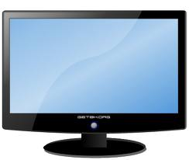
Sample 1 explain
GameRun
ColorFill
BackBuffer
Frame Buffer
Present
StretchRect
ColorFill
Surfaces

Slide 33
Sample 1 explain
GameRun
ColorFill
BackBuffer
Frame Buffer
Present
StretchRect
ColorFill
Surfaces

Slide 34

Sample 1 with bitmap
GameRun
ColorFill
BackBuffer
Frame Buffer
Present
StretchRect
Surfaces
D3DXLoadSurfaceFromFile
GameInit
kitty.bmp

Slide 35
Surfaces
LPDIRECT3DSURFACE9 back_buffer = NULL;
LPDIRECT3DSURFACE9 surface = NULL;
void GameInit(HWND hWnd) {
d3ddv->GetBackBuffer(0,0,D3DBACKBUFFER_TYPE_MONO,&back_buffer);
int result =
d3ddv->CreateOffscreenPlainSurface(
100, // width 100, // height
D3DFMT_X8R8G8B8, // format
D3DPOOL_DEFAULT, // where? (VRAM or RAM)
&surface,
NULL);
}

Slide 36
Surfaces
if (d3ddv->BeginScene()) {
int r = rand() % 255;
int g = rand() % 255;
int b = rand() % 255;
d3ddv->ColorFill(surface,NULL,D3DCOLOR_XRGB(r,g,b));
RECT rect;
rect.left = rand() % (SCREEN_WIDTH/2);
rect.top = rand() % (SCREEN_HEIGHT/2);
rect.right = rect.left + rand() % (SCREEN_WIDTH/2);
rect.bottom = rect.top + rand() % (SCREEN_HEIGHT/2);
d3ddv->StretchRect(
surface, // from
NULL, // which portion?
back_buffer, // to
&rect, // which portion?
D3DTEXF_NONE);
...

Slide 37
Too fast?
#define FRAME_RATE 30
int WINAPI WinMain(...
...
DWORD frame_start = GetTickCount();
DWORD count_per_frame = 1000 / FRAME_RATE;
while (!done) {
if (PeekMessage(&msg,NULL,0,0,PM_REMOVE)) {
if (msg.message==WM_QUIT)
done=1;
TranslateMessage(&msg);
DispatchMessage(&msg);
}
DWORD now = GetTickCount();
if (now - frame_start >= count_per_frame)
{
frame_start = now;
GameRun(hWnd);
}
}
Frequency: number of counts per second

Slide 38
Colored rectangle is boring?
D3DXLoadSurfaceFromFile (d3dx.h)
result = D3DXLoadSurfaceFromFile(
surface, // surface
NULL, // destination palette
NULL, // destination rectangle
“ball.bmp”
NULL, // source rectangle
D3DX_DEFAULT, // filter image
0, // transparency (0 = none)
NULL); // reserved

